Slide 1
Open Source Platform and Network Administration
Lesson 17

Slide 3
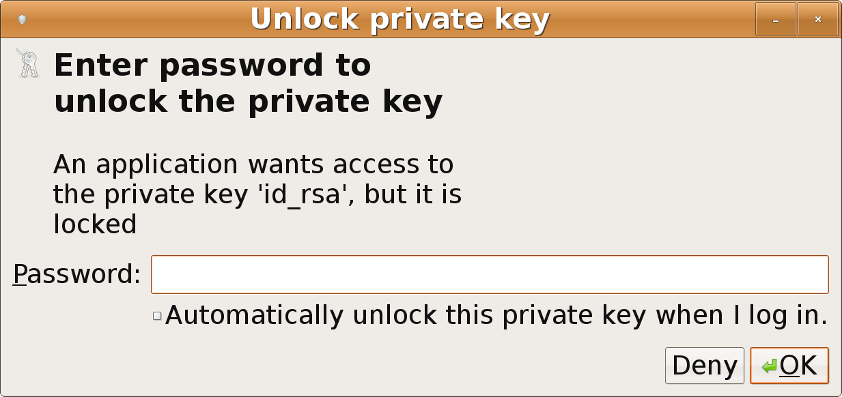
A Request for a Passphrase
Notes:
SSH client commands: ssh, scp, and sftp
Authentication:
Username/password
Passphrase with public/private keys
One-time passwords
Kerberos

Slide 4
Networks and Encryption
Secure Shell (SSH)
Internet Protocol Security (IPSec)
Secure Sockets Layer (SSL)/Transport Layer Security (TLS)

Slide 5
IPSec
Works at both ends of a connection
Tunnels communications through ports 50 and 51
In tunneling mode, is a form of virtual private networking

Slide 6
Protocols Used for IPsec
Encapsulating Security Payload (ESP) protocol
Uses protocol number 50
ESP traffic can be allowed through an iptables firewall with a -p 50 -j ACCEPT switch
Authentication Header (AH) protocol
Uses protocol number 51
AH traffic can be allowed through an iptables firewall with a -p 51 -j ACCEPT switch

Slide 7
Protocols Used for Ipsec (Cont.)
Internet Key Exchange (IKE) protocol
Uses the User Datagram Protocol (UDP) over port 500
IKE traffic can be allowed through an iptables firewall with a -p udp --dport 500 -j ACCEPT switch

Slide 8
Protocols Used for Ipsec (Cont.)
Network Address Translation (NAT) traversal protocol
Uses the Transmission Control Protocol (TCP) and UDP over port 4500
NAT traffic can be allowed through an iptables firewall with -p tcp --dport 4500 -j ACCEPT and -p tcp --dport 4500 -j ACCEPT switches

Slide 9
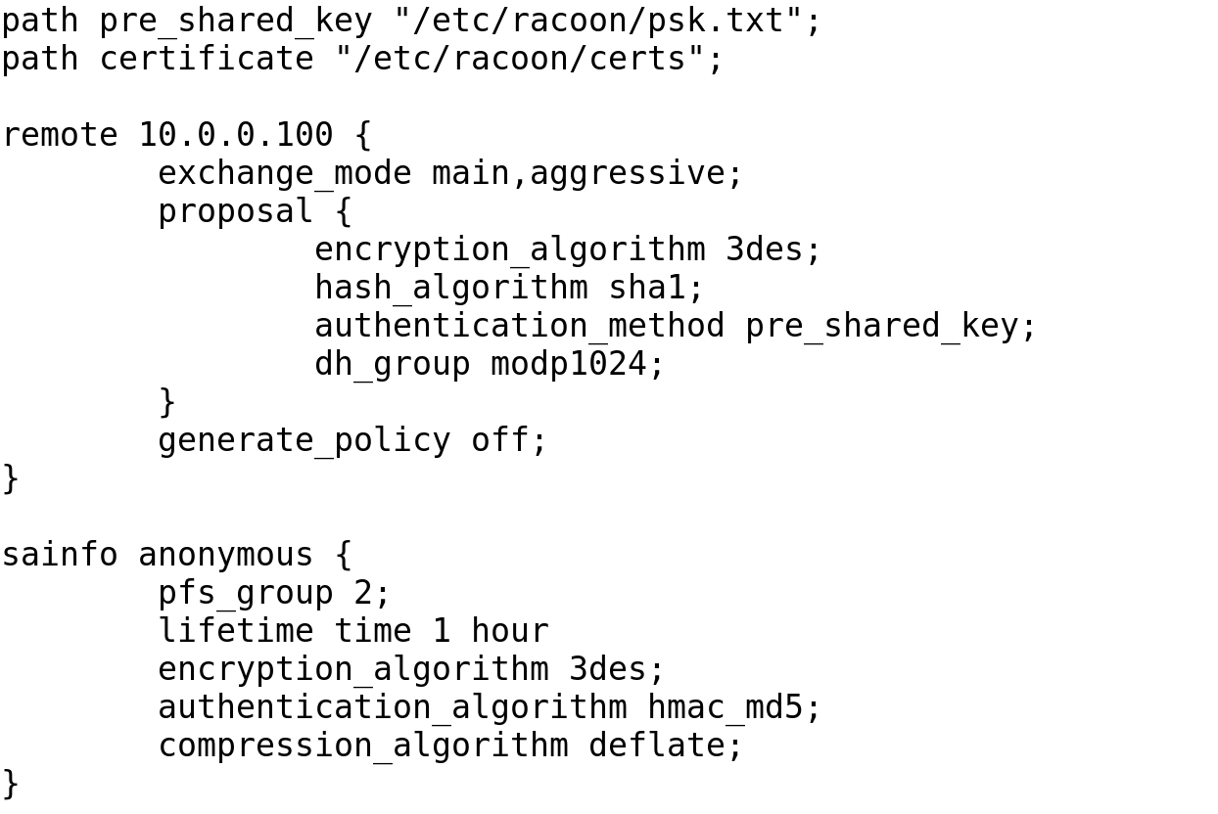
An /etc/racoon/racoon.conf File
Notes:
An /etc/racoon/racoon.conf File for Host-to-Host IPsec Connections

Slide 10
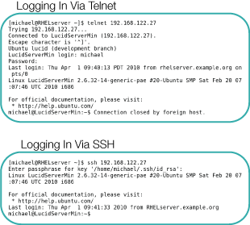
Telnet vs. SSH
Notes:
SSH client commands: ssh, scp, and sftp
Authentication:
Username/password
Passphrase with public/private keys
One-time passwords
Kerberos

Slide 11
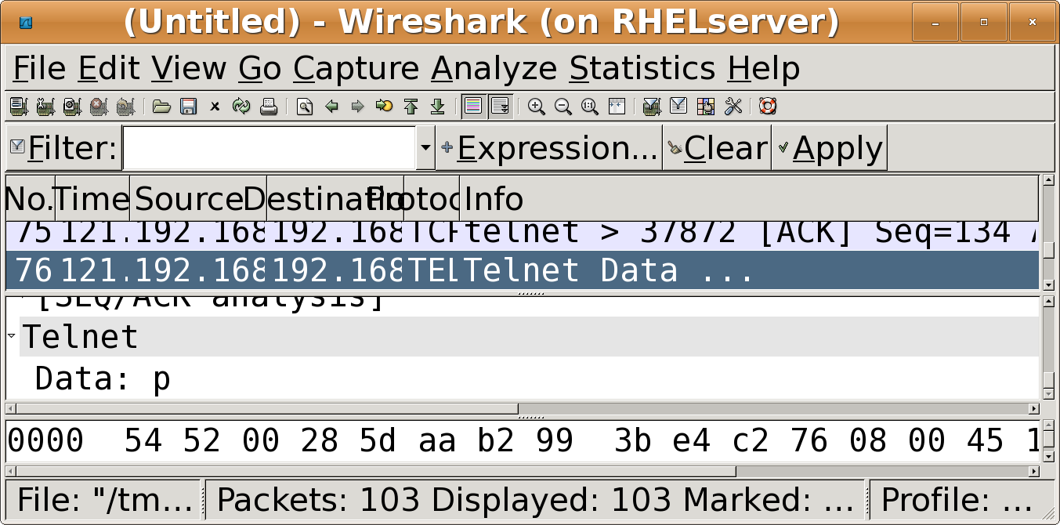
The Problem with Clear Text
Notes:
SSH client commands: ssh, scp, and sftp
Authentication:
Username/password
Passphrase with public/private keys
One-time passwords
Kerberos

Slide 12
Summary
File-sharing with Network File System (NFS) and Samba
Secure remote access tools
Encryption with Secure Shell (SSH) and the Internet Protocol Security (IPsec) protocol

